Slide 1

SmartConnect
-Networking is never been easier-
Design Team 9
Atefeh Mahdavi Goloujeh - Anushree Srivastava - Akhil Reddy Yakkaluri

Slide 2





The Big Idea
Improving the communication and networking among Students and Professors in Educational Institutions.

Slide 3
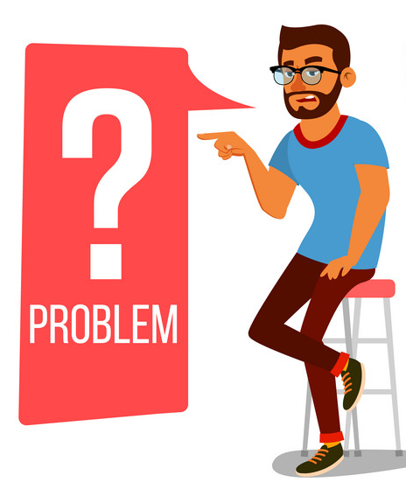
Problems
Personas
Student- Krishna, a graduate student at UNCC
Professors - Mr. Ahmadi, a professor in University of Tehran
Inefficient way of scheduling meeting
Uncertainty of seeing the professor during busy office hours
No discussion board
No official chat/call platform

Slide 4

Solution?
Easy to contact professors.
Easier to check professor’s availability and book concrete time slot.
Discussion board/forum to post issues or find answers.
Chat with your colleagues/Professors.

Slide 5
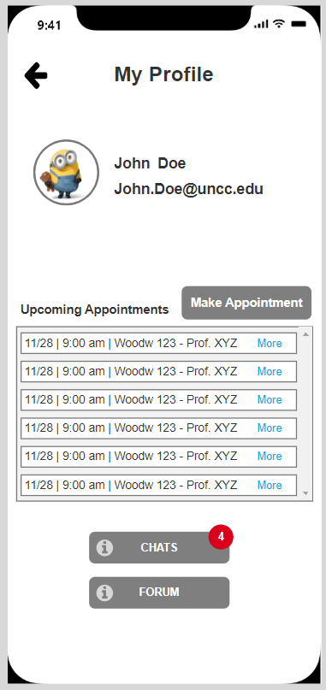
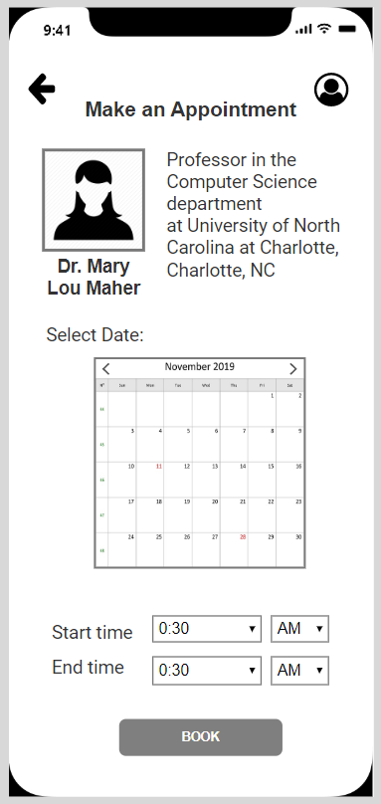
SmartConnect Features
Profile Page
Book an Appointment

Slide 6
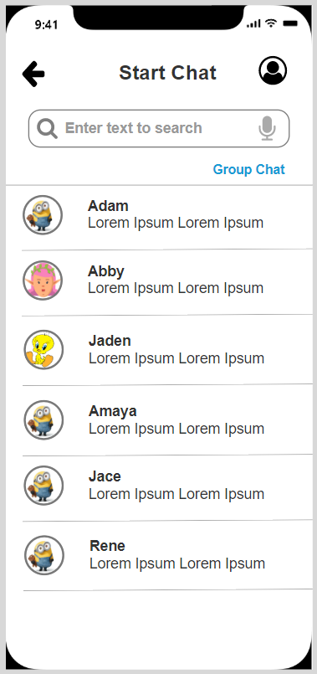
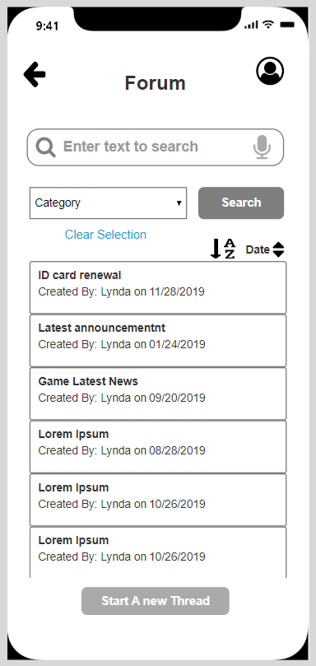
Chat Page
Forum Page

Slide 7
User Evaluation
Most of the users thought it is a good idea to have everything at one place.
Users mainly loved the simplicity in booking appointments.
They thought it would have been better to have email feature also.
Few users questioned about how it is different from whatsapp?
They gave suggestion to incorporate group appointment booking.

Slide 8
Future Enhancements
We haven’t address the features from professors’ point of view.Like Do not disturb mode, how professors can put their available time slots.
More polished UI.
Email incorporation for formal communication.
Group time slot booking

Slide 9
Questions?

